Slide 1






Principal Partner
Legal advisor
Implementation Partners
Session supported by
Lagos, Nigeria,
28 September 2021

Slide 2
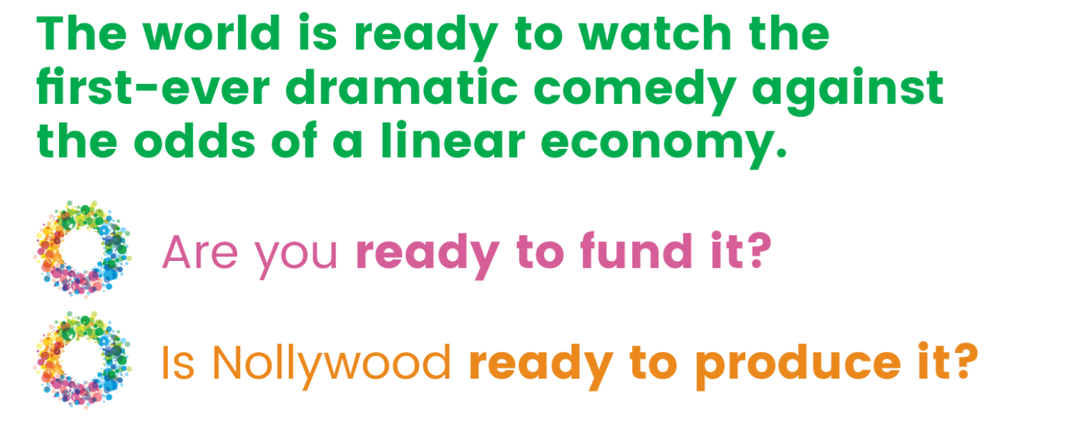
Principal Partner
Legal advisor
Implementation Partners
Lagos, Nigeria,
28 September 2021

Slide 3

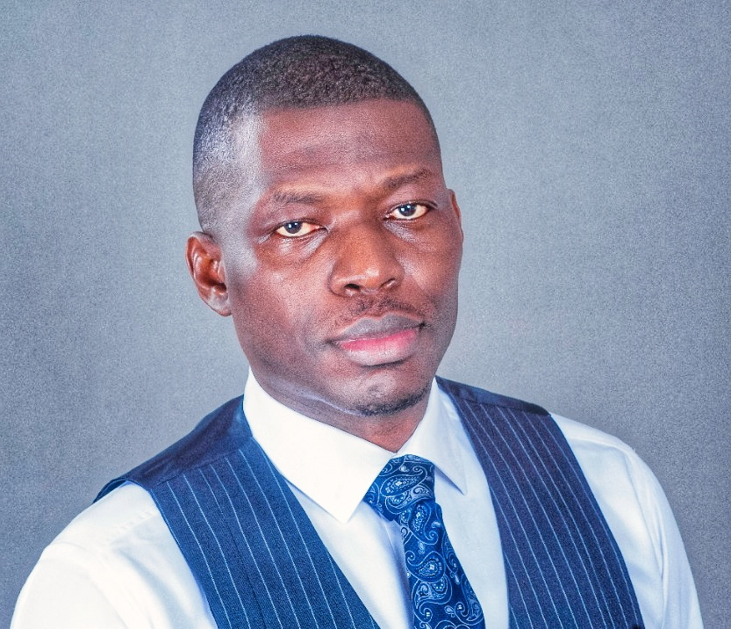
Dipo Adesida
COO Verdant Zeal
Moderator
Principal Partner
Legal advisor
Implementation Partners
Lagos, Nigeria,
28 September 2021

Slide 4
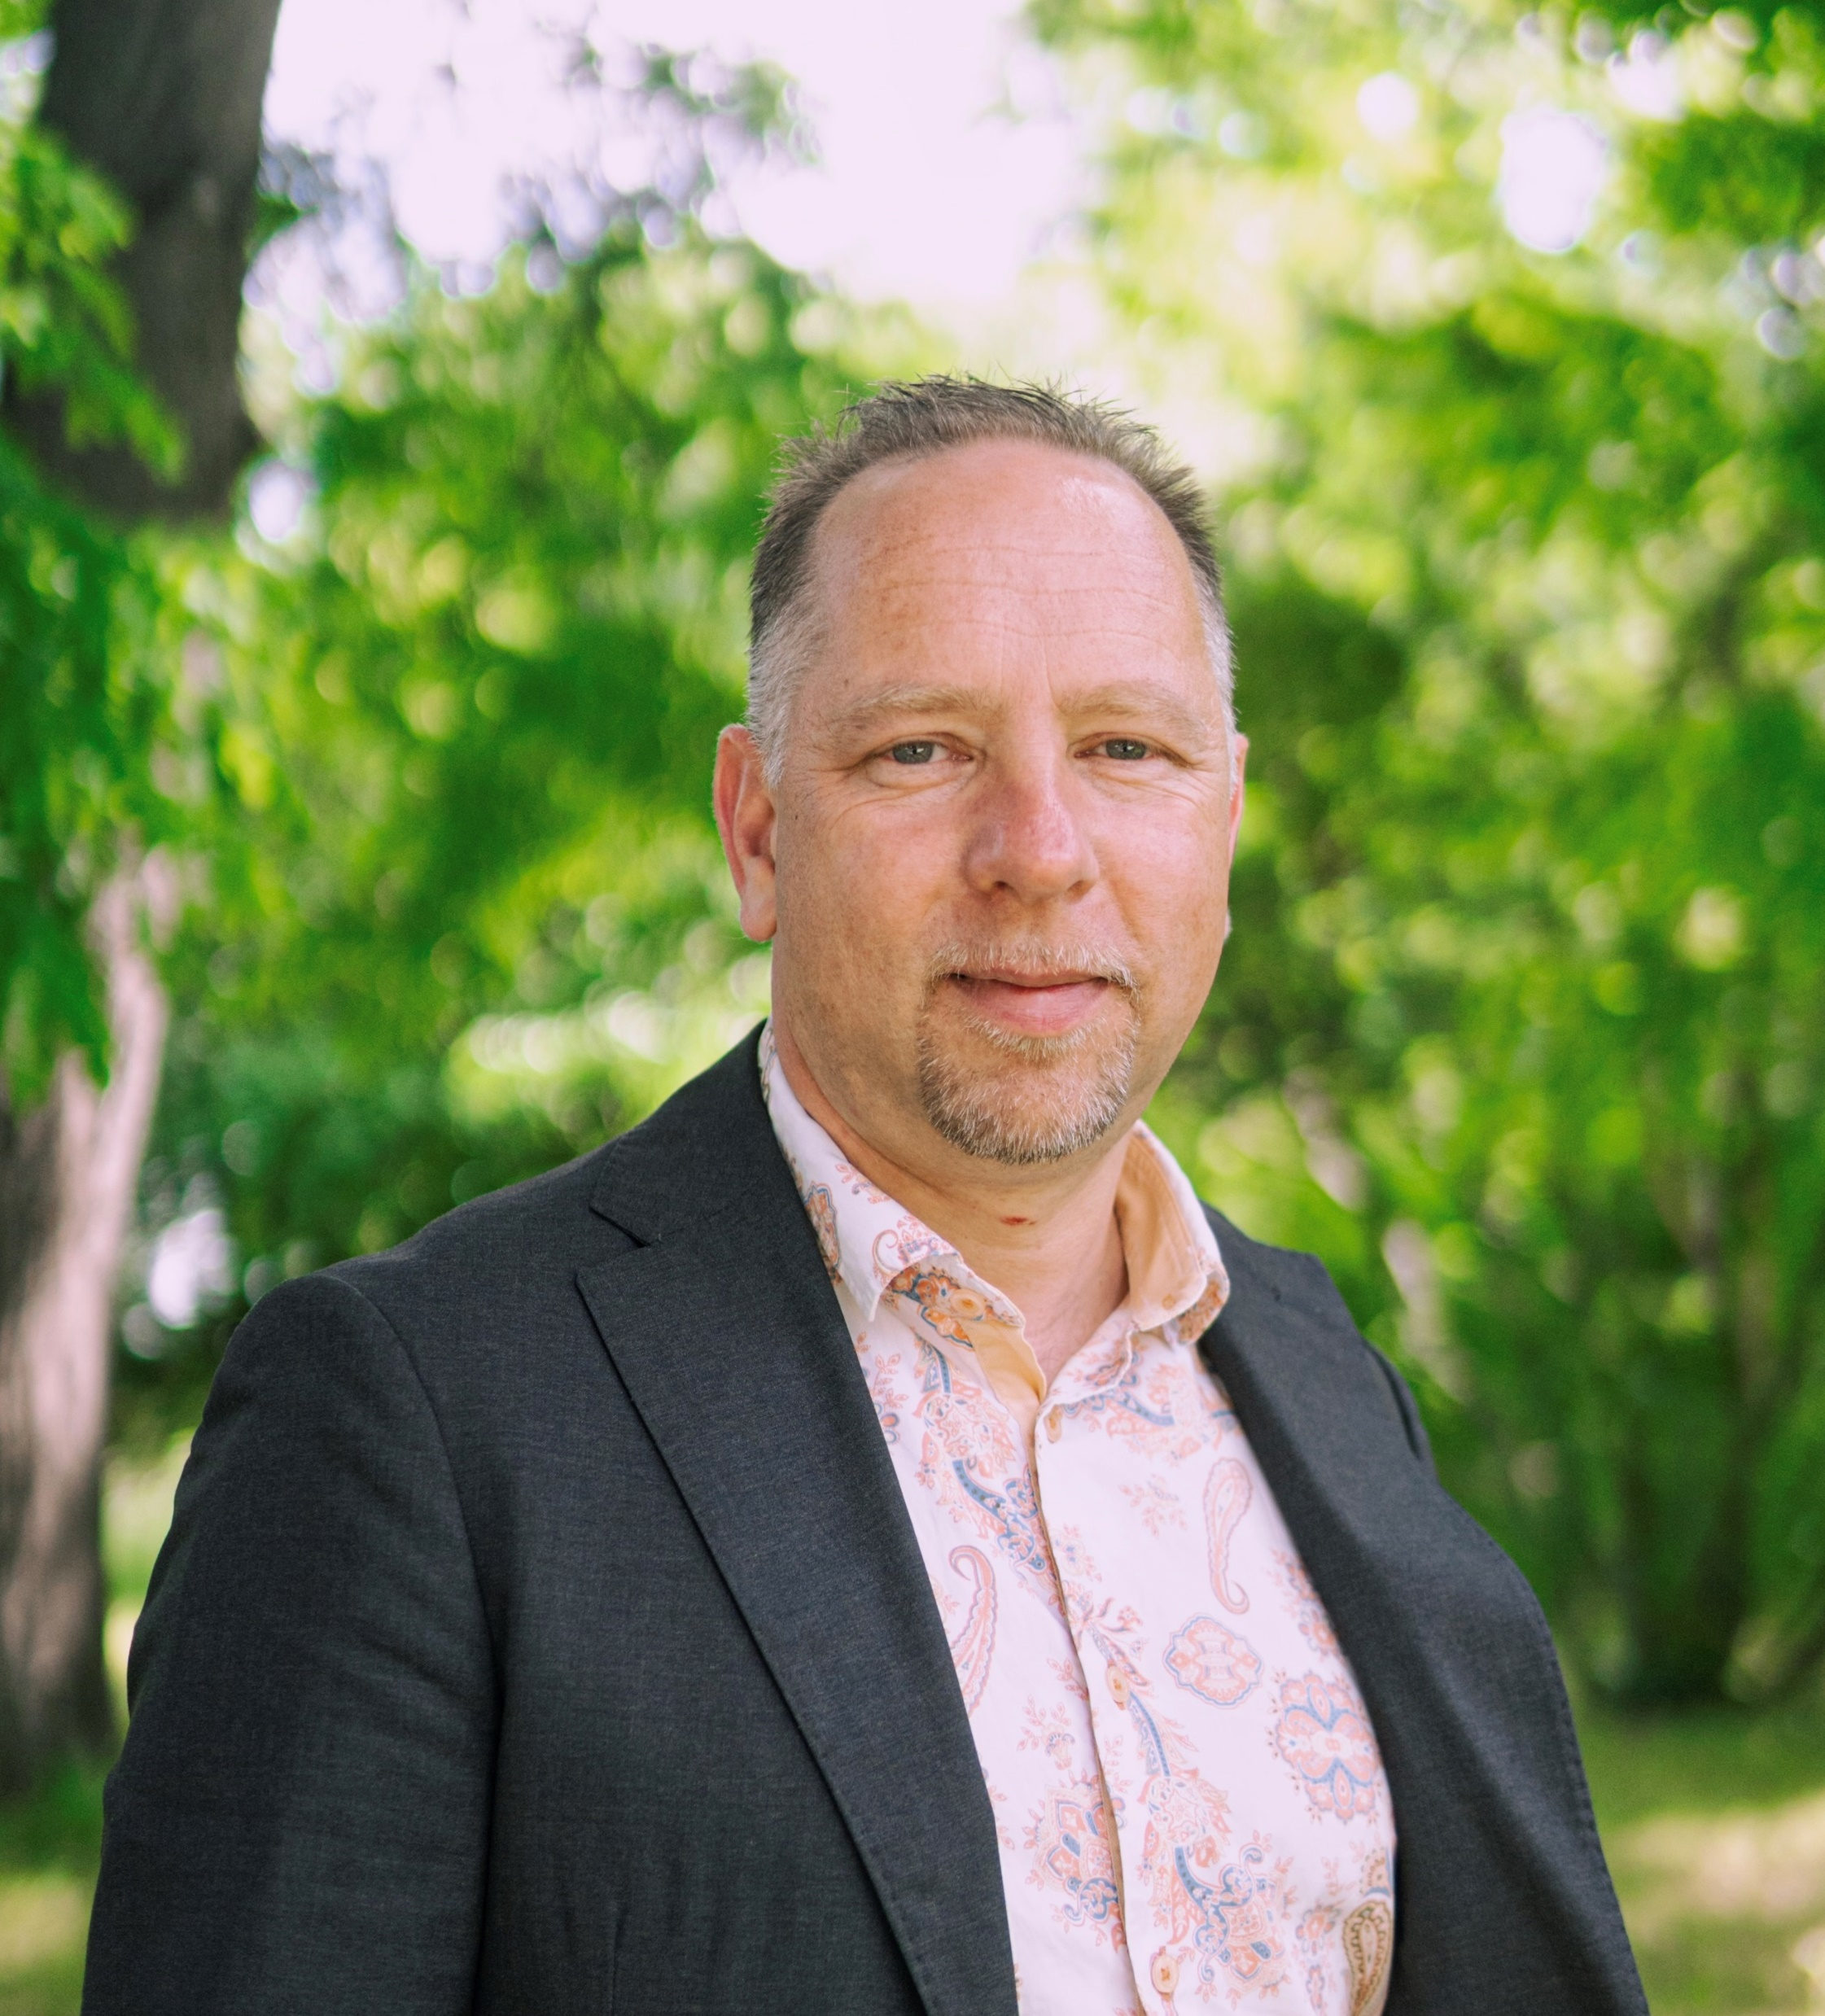
Sören Bauer
REVOLVE Circular
President
Principal Partner
Legal advisor
Implementation Partners
Lagos, Nigeria,
28 September 2021

Slide 5
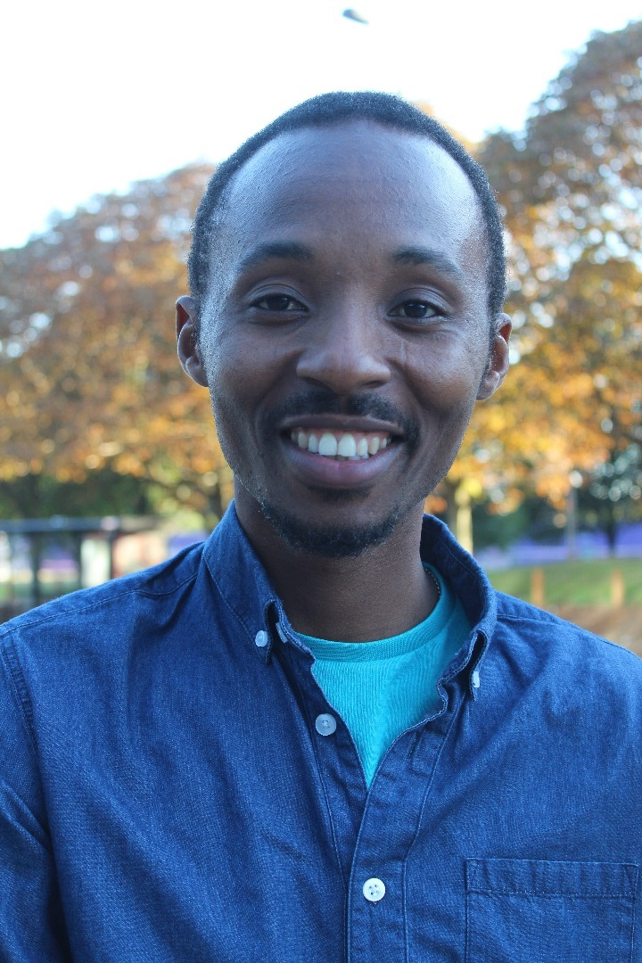
Sunkanmi Adebayo
Underdog Productions
Head of Productions
Principal Partner
Legal advisor
Implementation Partners
Lagos, Nigeria,
28 September 2021

Slide 6
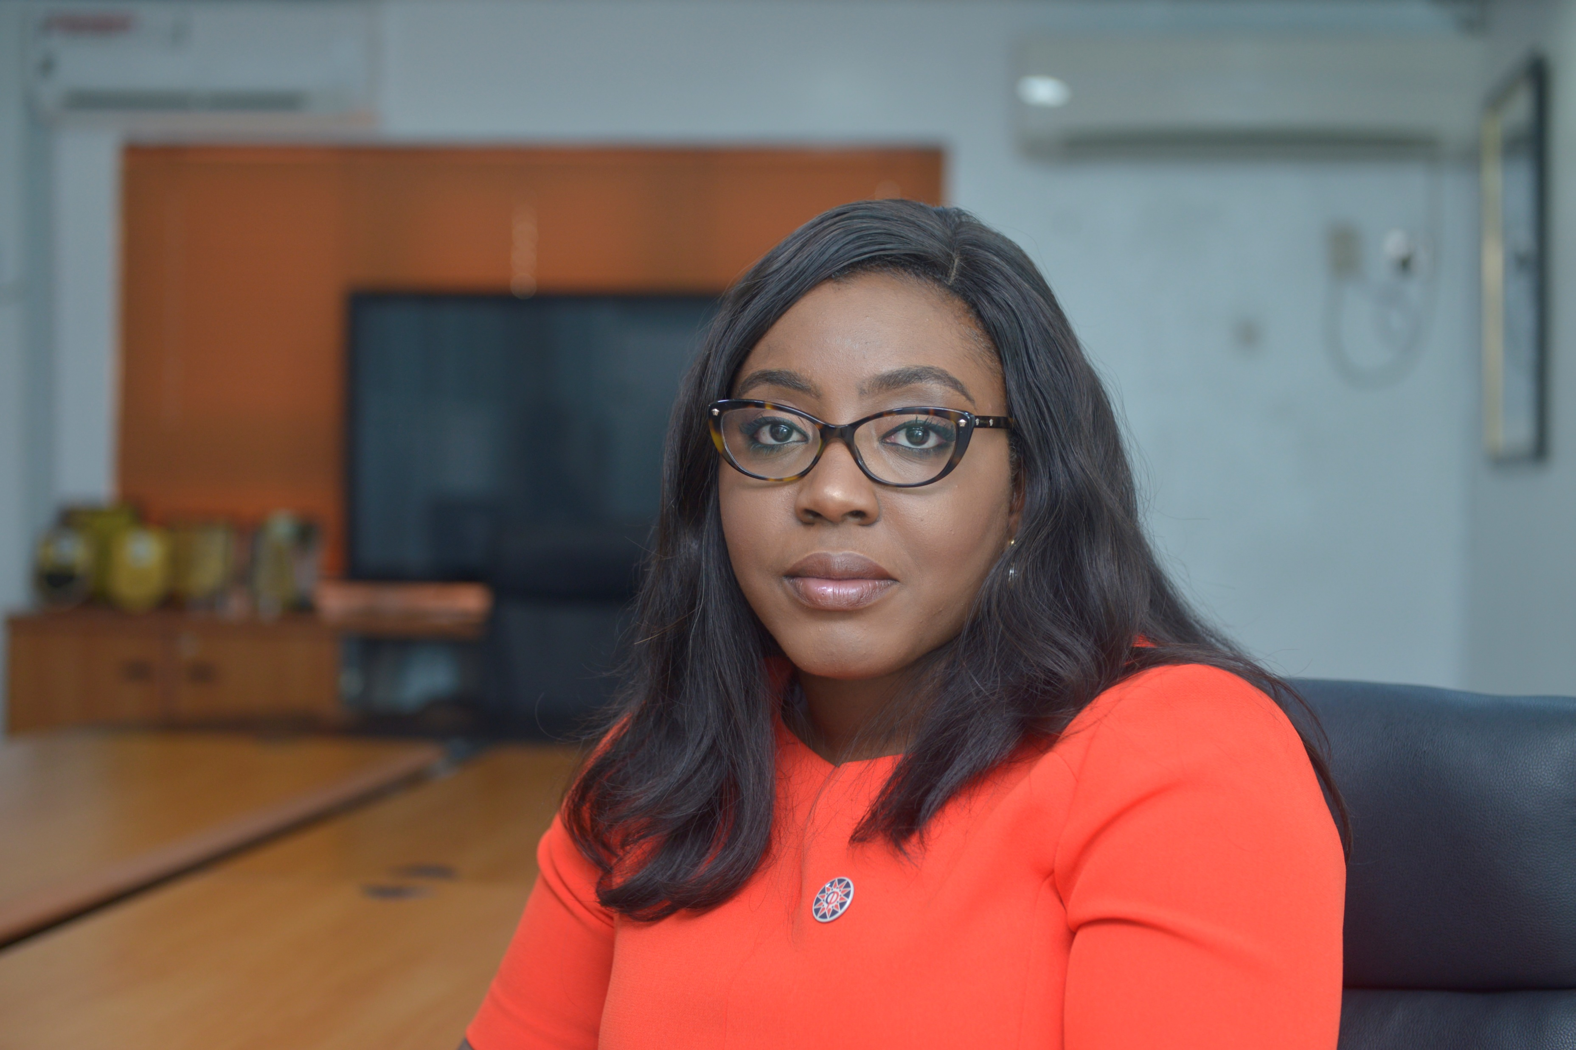
Isioma Idigbe
Punuka Attorneys & Solicitors
Senior Associate
Principal Partner
Legal advisor
Implementation Partners
Lagos, Nigeria,
28 September 2021

Slide 7
So, what is the circular economy?
… and how we will turn it into a dramatic comedy
Principal Partner
Legal advisor
Implementation Partners
Lagos, Nigeria,
28 September 2021

Slide 8
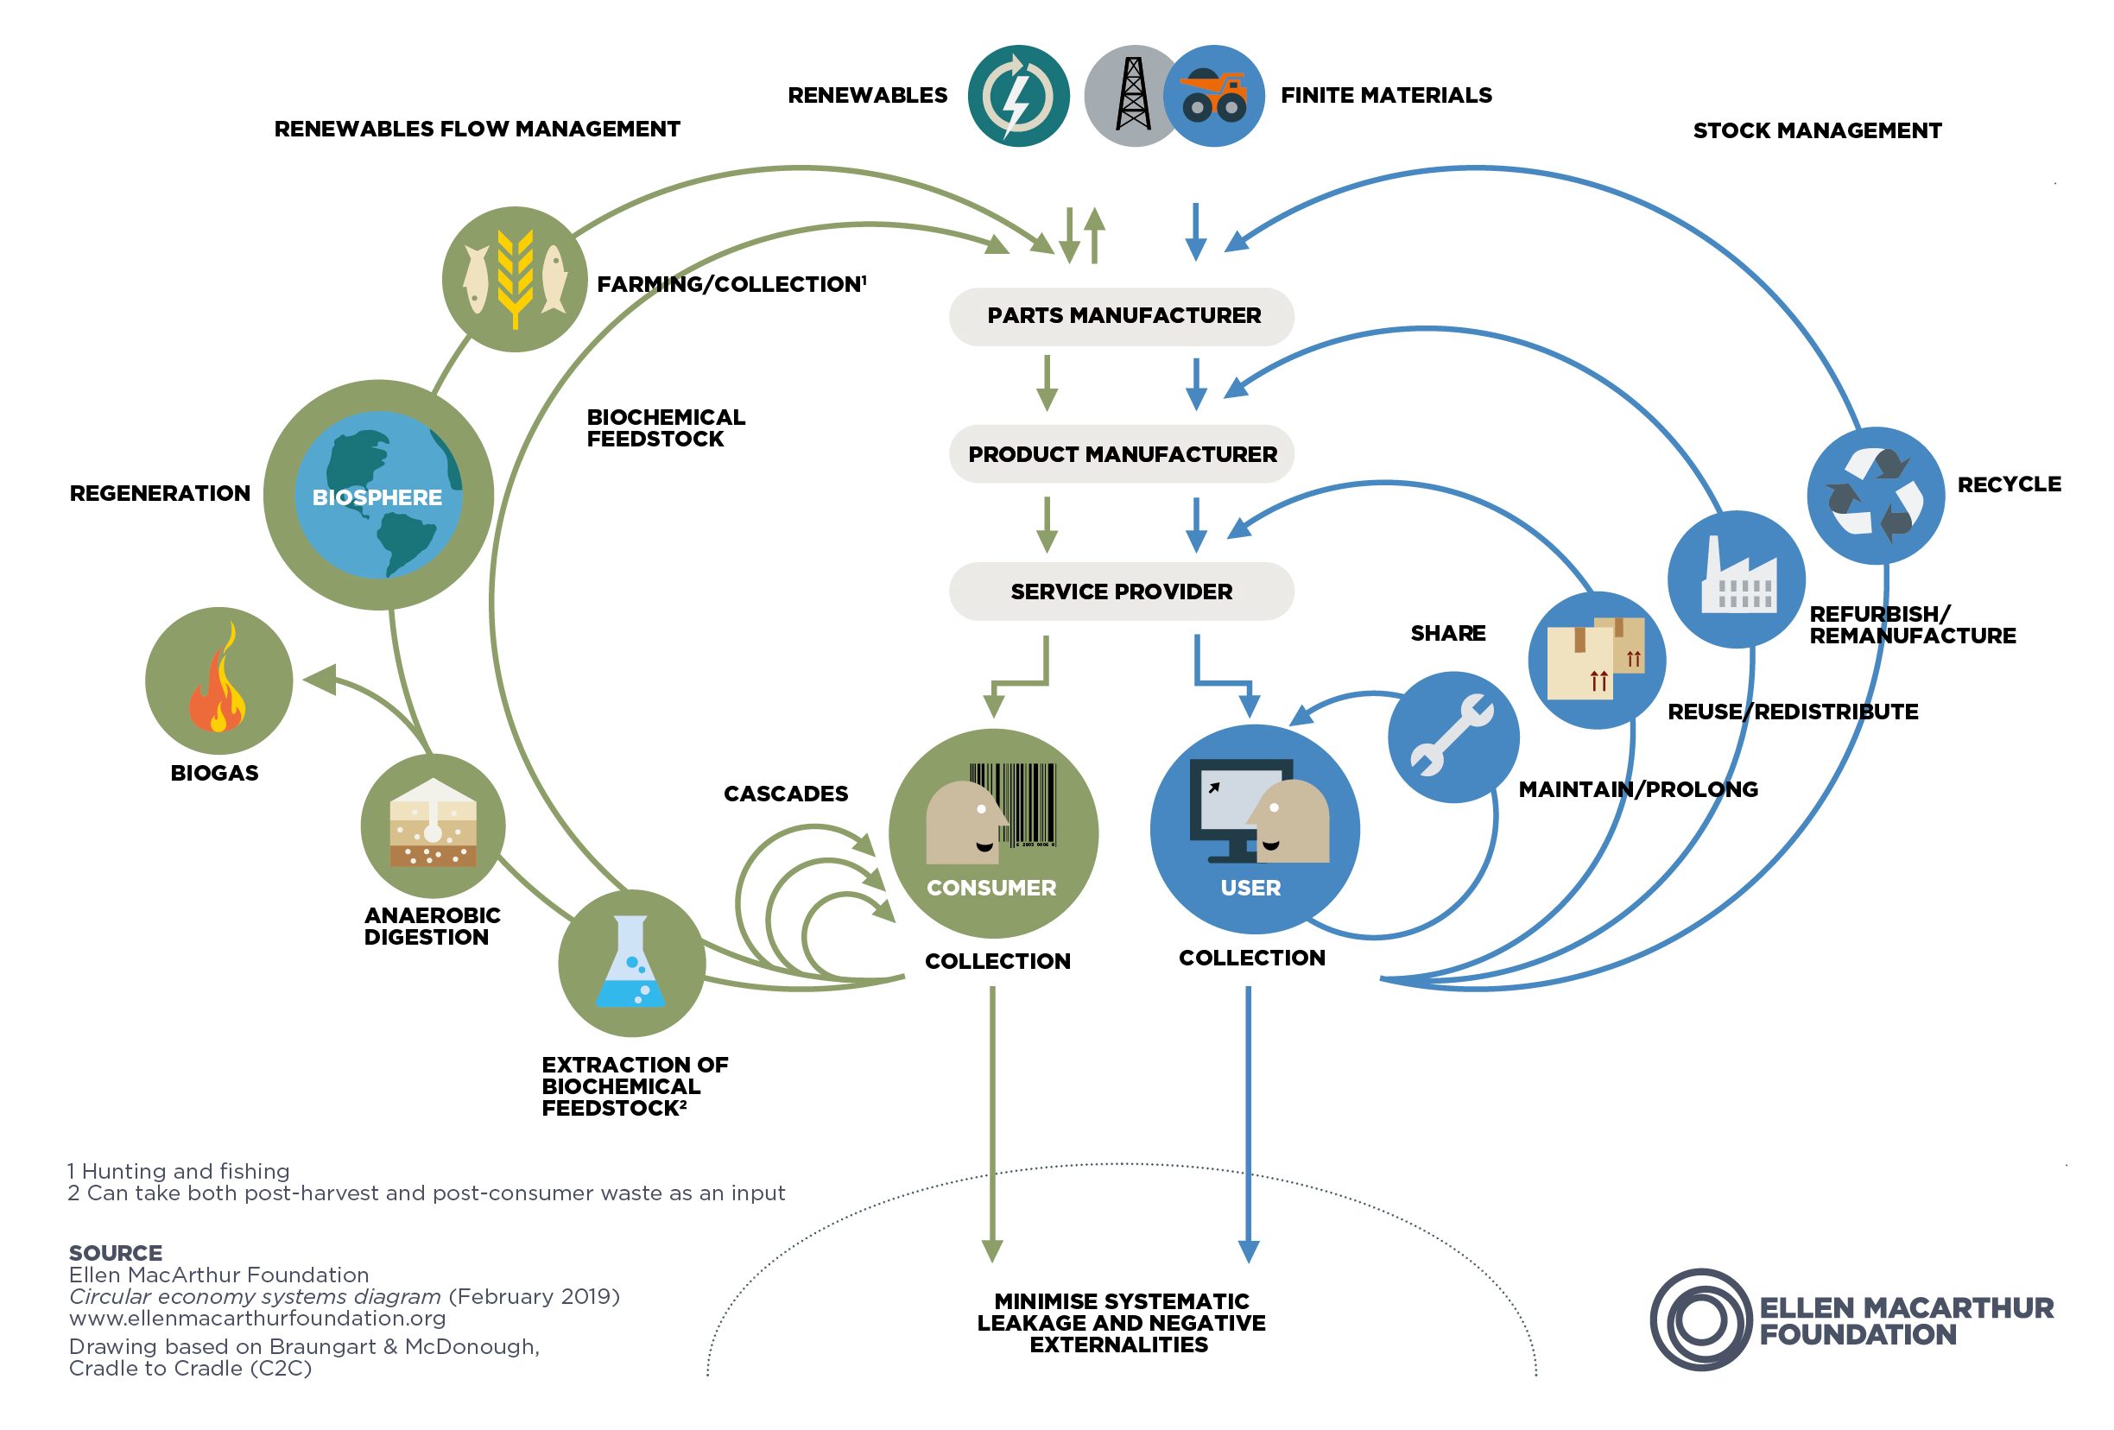
Principal Partner
Legal advisor
Implementation Partners
Lagos, Nigeria,
28 September 2021

Slide 9
From theory to storytelling:
four stories about how Circular thinking succeeds …
1. Pineapple leather
2. From mobile phones to e-waste, to Lagos, and back to France’s repairability index
3. From mass timber as a resource to building with straw bales
4. Industrial symbiosis and the waste hierarchy
Principal Partner
Legal advisor
Implementation Partners
Lagos, Nigeria,
28 September 2021

Slide 10
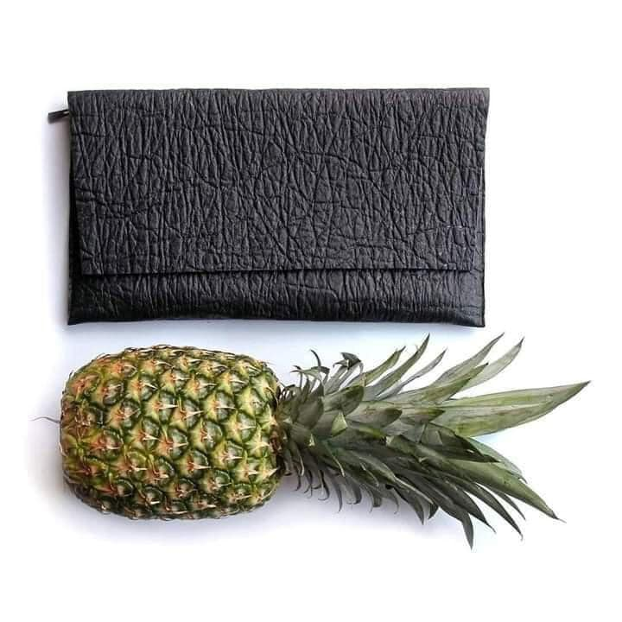
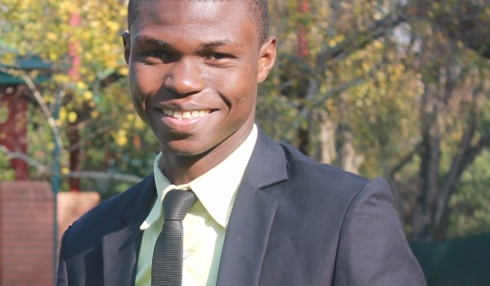
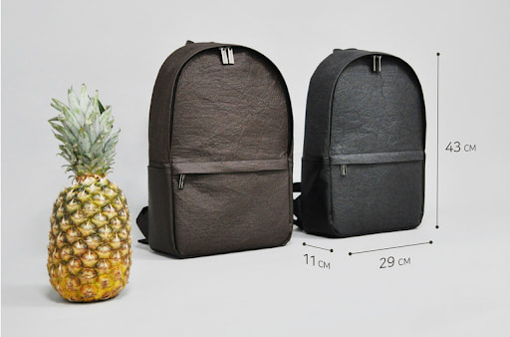
Pineapple leather
TYEGRO CI
Principal Partner
Legal advisor
Implementation Partners
Lagos, Nigeria,
28 September 2021

Slide 11


Principal Partner
Legal advisor
Implementation Partners
Lagos, Nigeria,
28 September 2021

Slide 12
Principal Partner
Legal advisor
Implementation Partners
Lagos, Nigeria,
28 September 2021

Slide 13
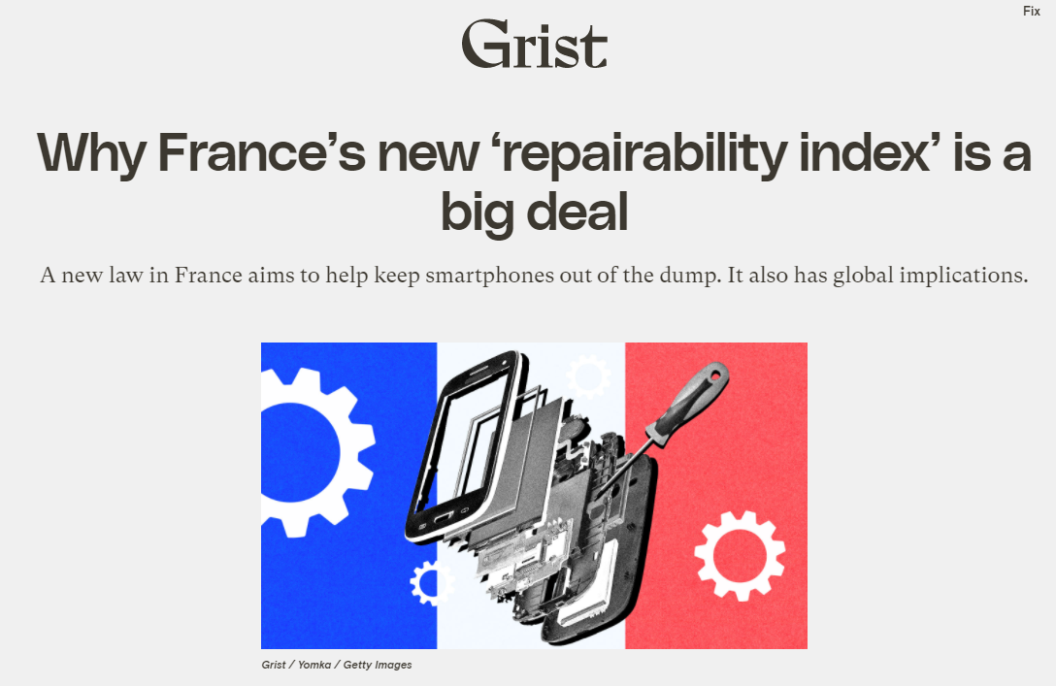
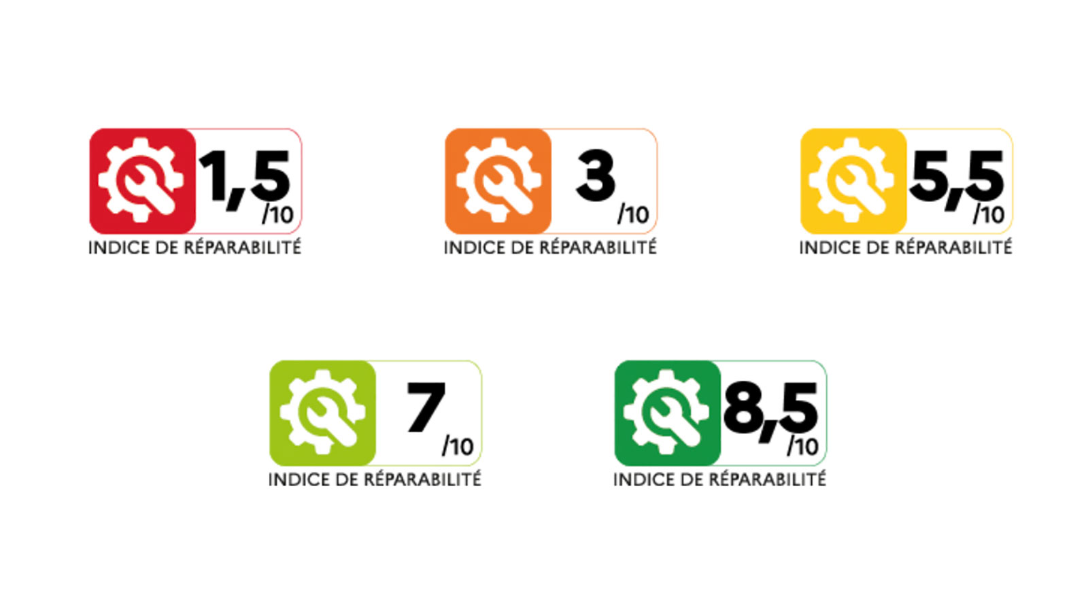
Principal Partner
Legal advisor
Implementation Partners
Lagos, Nigeria,
28 September 2021

Slide 14
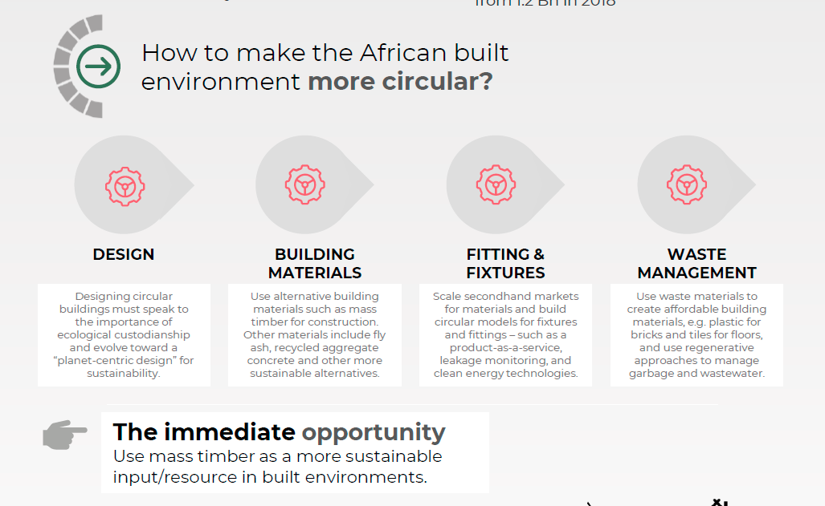
Circular Economy in construction:
local materials, modular components & more
Principal Partner
Legal advisor
Implementation Partners
Lagos, Nigeria,
28 September 2021

Slide 15
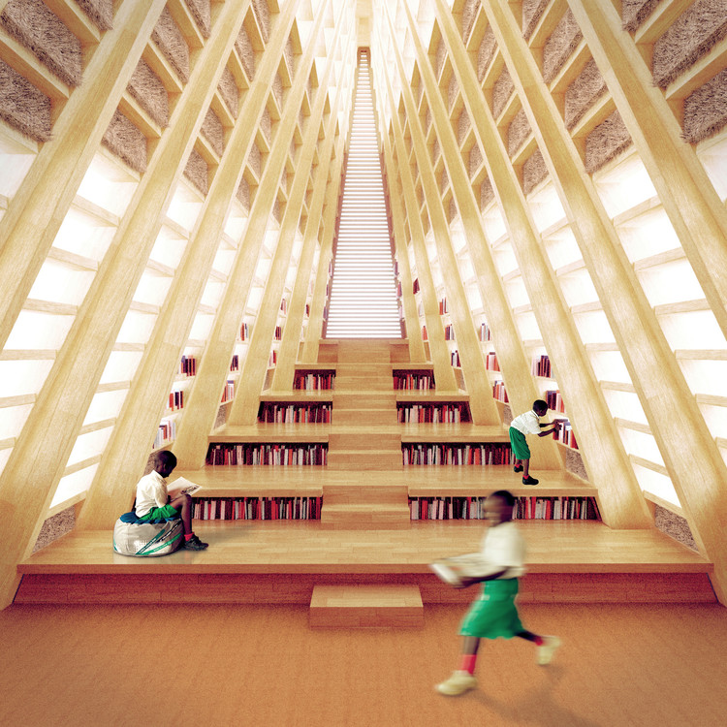
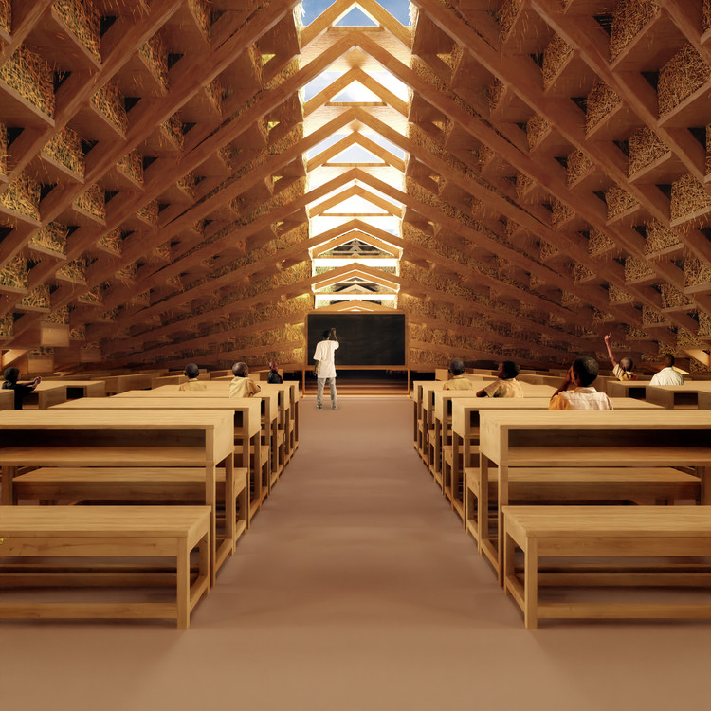
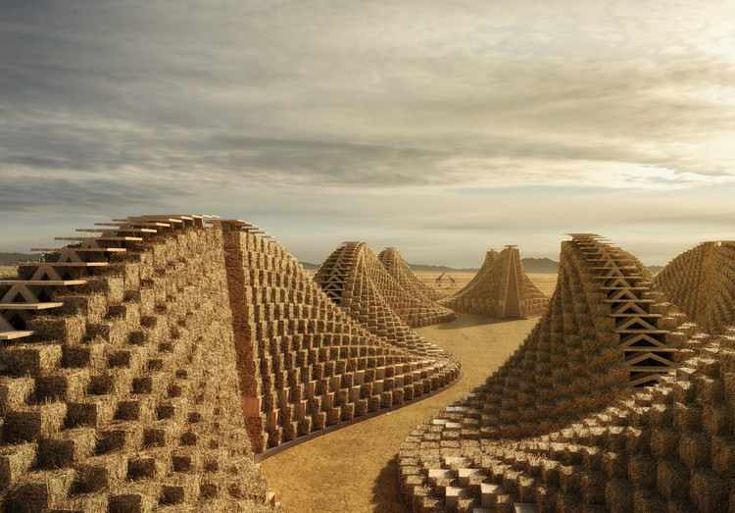
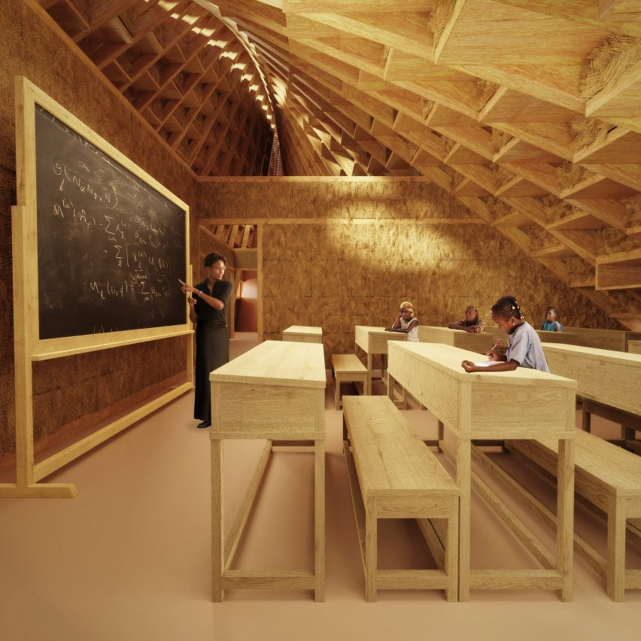
Circular Economy in construction:
local materials, modular components
Straw Bale school in Malawi by Nudes
Principal Partner
Legal advisor
Implementation Partners
Lagos, Nigeria,
28 September 2021

Slide 16
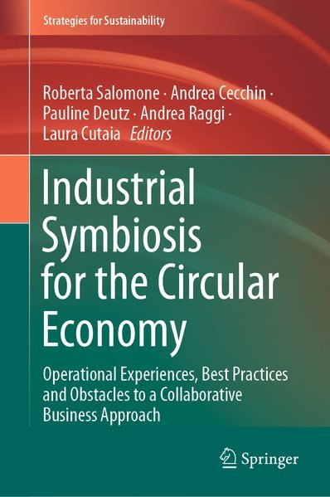
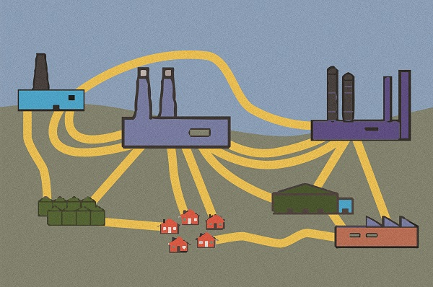
Industrial symbiosis
… is when one industry’s or company’s waste is another company’s resource …
Principal Partner
Legal advisor
Implementation Partners
Lagos, Nigeria,
28 September 2021

Slide 17
Systemic change needs to happen in terms of consumer behavior, and the way we produce and run the global economy. This change has to happen live - in our brains, corporate board rooms, and parliaments.
Circularity has this mindset - and succeeds by taking over from the liner economy. Slowly but surely.
Thank you!
Principal Partner
Legal advisor
Implementation Partners
Lagos, Nigeria,
28 September 2021

Slide 18
Sunkanmi Adebayo
Underdog Productions
Head of Productions
Principal Partner
Legal advisor
Implementation Partners
Lagos, Nigeria,
28 September 2021

Slide 19
Isioma Idigbe
Punuka Attorneys & Solicitors
Senior Associate
Principal Partner
Legal advisor
Implementation Partners
Lagos, Nigeria,
28 September 2021

Slide 20
Principal Partner
Legal advisor
Implementation Partners
Lagos, Nigeria,
28 September 2021

Slide 21
Thank you!
Principal Partner
Legal advisor
Implementation Partners
Lagos, Nigeria,
28 September 2021

